Slide 1
SyneMobiSafe Onshore Training
Vishal Bhardwaj

Slide 2
SyneMobiSafe Overview

Slide 3
Introduction to SyneMobiSafe
SyneMobiSafe Overview
What is SyneMobiSafe?
Why it is used?
Advantages of SyneMobiSafe
Benefits of SyneMobiSafe implementation
SyneMobiSafe Modules Overview
Cloud Data Backup Module
Device Recovery Module
Device Protection and Security Module
Advance Tech Support & Live Chat Module
Telemetry and Data Analysis Module

Slide 4
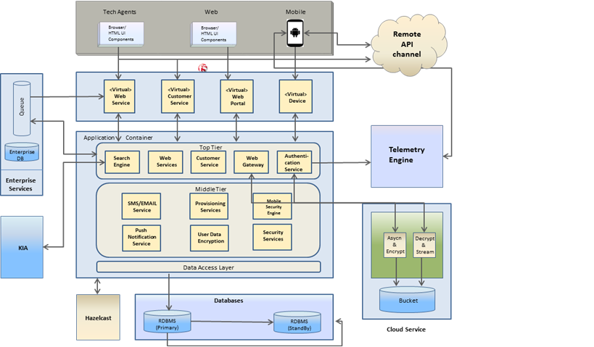
Architecture Of SyneMobiSafe

Slide 5
Multi-Layered Architecture

Slide 6
Layers In SyneMobiSafe
What is Multi-Layered Architecture?
Layers In SyneMobiSafe Architecture
Enterprise or Business Layer
Data Access Layer
Presentation layer (User Interface)
Application Layer
Benefits of Layered Architecture

Slide 7
Multi-Tiered Architecture

Slide 8
Layers In SyneMobiSafe
What is Multi-Tiered Architecture?
Tiers In SyneMobiSafe Architecture
Client Tier (Mobile Device)
Web Tier (SyneMobiSafe Web Portal running on Web Server)
App Tier (SyneMobiSafe business logic code running on Application Server)
Database Tier (SyneMobiSafe database)
Benefits of Tiered Architecture

Slide 9
SyneMobiSafe Modules Overview

Slide 10
SyneMobiSafe Modules
Cloud Data Backup Module
Importance of Cloud services
Algorithm used for auto backup
Secured and encrypted stream usage for data backup
User Configuration options
Device Recovery Module
Why device recovery is necessary
Functions and services provided under the module.

Slide 11
SyneMobiSafe Modules
Device Protection and Security Module
Advantages of the module
Risk management against vulnerabilities
Security measures and criteria
Other services
Device Health Monitoring Module
Benefits of the module
Algorithm Implementation for device performance

Slide 12
SyneMobiSafe Modules
Advance Tech Support and Live Chat Module
Overview and implementation of the module
End to end support process
Categorized support options
Live Chat features and options
Telemetry and Data Analysis Module
Importance of Effective Data Analysis
Measuring real time user experience
Personalized Engagement
User Configurable options for report generation

Slide 13
SyneMobiSafe Modules
KIA Module
Knowledge based module
Value added feature
Search functionality
Implementation and algorithm used

Slide 14
Distributed System

Slide 15
Concept of Distributed System
Distributed System Architecture
Configuration
Load balancer
Cache Server
Database Replication
Deployment in Distributed Environments
Requirements
Challenges
Benefits of Distributed System

Slide 16
SyneMobiSafe Guidelines
Template Code Generation for Common Functionalities
Encourages user to develop application as per best practices
Important factors to achieve application responsiveness
Code reusability
Follow naming convention
Unit Test Cases Support

Slide 17
Configuration and Troubleshooting

Slide 18
SyneMobiSafe Configuration
Configuration Options
Database Level Configuration
Build process configuration to deploy over Dev and QA environments
App server configuration
Pre-requisites before deployment over production environment
Setup and customize tools for automated build process
Application Static and Dynamic Configuration
Static configuration which cannot be changed at run-time (e.g. DB configuration)
Dynamic configuration which can be changed at run-time without restarting the application (e.g. log level)

Slide 19
SyneMobiSafe Trouble Shooting
Logging
Enable/disable logging
Log Monitoring and Analysis
Log deletion, rolling and archiving options
Application Error Codes
Error Codes, Description and Resolution
Steps to identify and trouble shoot common issues
Debugging
Debug process; attaching to debugger process; adding breakpoints and execution

Slide 20
Thank You!

